Slide 1
Pizza Sales Analytics: Optimizing Performance and Customer Satisfaction for PizzaXpress

Slide 2
Agenda
Objective
Background
Key findings
Recommendations
Appendix:
Data methodology

Slide 3
Objective
Our project offers the client flexibility in accessing insights based on their preference.
For a detailed technical view of the approach used to create KPIs and trends, the SQL report provides a comprehensive analysis.
Additionally, for a quick glance at the final numbers of the KPIs, SQL offers a straightforward presentation.
For those interested in a more interactive and visually appealing experience with the ability to filter and drill down into specific data points using slicers and other tools, the Power BI dashboard is available.
This dual approach ensures that the client can choose the format that best suits their analytical needs.
Analyze sales data to identify trends and patterns in customer behavior.
Gain insights into customer preferences for pizza categories and sizes.
Determine the average number of pizzas per order and average order value.
Identify top-selling and underperforming pizzas by revenue, quantity, and orders.
Develop a comprehensive dashboard to visualize key performance indicators (KPIs) and trends.

Slide 4
Background
In the fiercely competitive food industry, understanding customer preferences and optimizing operational efficiency is crucial for success.
Our client, PizzaXpress, sought to enhance its business intelligence capabilities to improve decision-making and drive growth.
The goal of this project was to analyze sales data and customer behavior to uncover valuable insights that could be used to increase sales, improve customer satisfaction, and streamline operations.

Slide 5
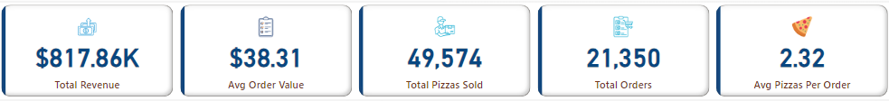
Key Findings
Key Performance Indicators(KPIs):
In the year 2015, PizzaXpress did a business of $817.86K.
On an average their order value was $38.31.
They completed 21,350 orders and sold 49,574 Pizzas in total with an average of 2.32 Pizzas per order.

Slide 6
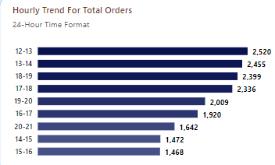

Key Findings
Hourly Trend for Total Orders:
The time intervals 12-13,13-14,18-19 and 17-18 relatively received higher number of orders when compared to the rest of the day .
Very few number of orders were received for the intervals 9-10,10-11 and 23-24.

Slide 7
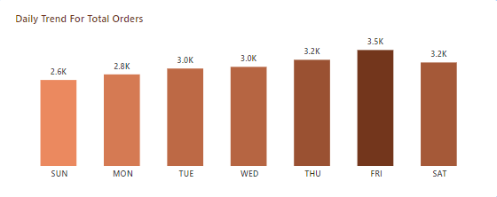
Key Findings
Daily Trend for Total Orders:
Friday was the busiest day in terms of total orders received by the business followed by Thursday and Saturday.
Amongst all the days, Sunday had the least number of orders.

Slide 8
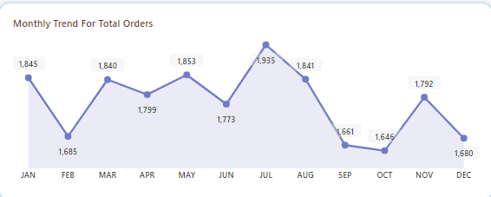
Key Findings
Monthly Trend for Total Orders:
July was the busiest month in terms of total orders received by the business followed by May and January.
Amongst all the months, October had the least number of orders followed by September and December.

Slide 9
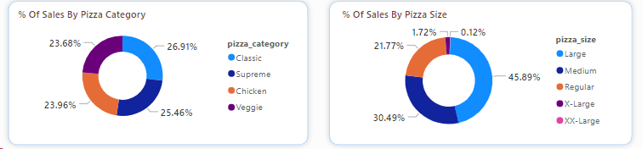
Key Findings
% Of Sales By Pizza Category & Size:
From a business perspective, the categories had approximately an equal split in terms of sales.
The Large size accounted for the highest sales followed by Medium and Regular respectively.

Slide 10
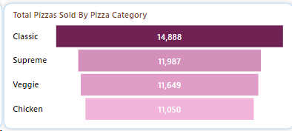
Key Findings
Total Pizzas Sold By Pizza Category:
Classic category was sold the most followed by Supreme and Veggie.
Chicken category was the least sold category.

Slide 11
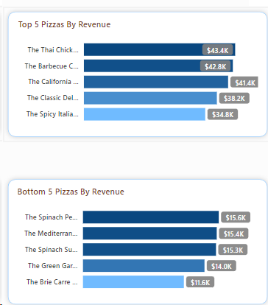
Key Findings
Top & Bottom 5 Pizzas By Revenue:
The Thai Chicken Pizza generated the highest revenue amongst all the pizzas followed by The Barbecue Chicken Pizza and The California Chicken Pizza.
The Brie Carre Pizza had the least revenue amongst all the pizzas.

Slide 12
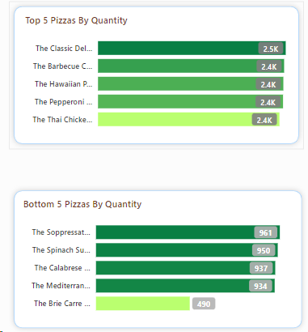
Key Findings
Top & Bottom 5 Pizzas By Quantity:
The quantity sold for each pizza in the Top 5 list was approximately equal.
The Brie Carre Pizza was the least sold amongst all the pizzas.

Slide 13
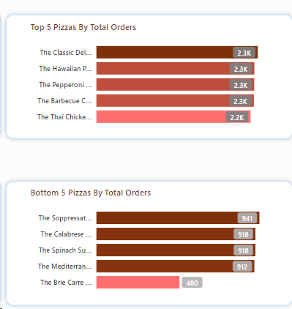
Key Findings
Top & Bottom 5 Pizzas By Total Orders:
The total number of orders for each pizza in the Top 5 list was approximately equal.
The Brie Carre Pizza had the least number of total orders amongst all the pizzas.

Slide 14
Recommendations
Implement a comprehensive strategy focusing on menu optimization, promotion of bundle deals, targeted marketing on high-volume days, customer retention programs, operational efficiency improvements, and strategic market expansion.
These initiatives will capitalize on the insights from 2015, driving increased sales and customer satisfaction.
Implement dynamic pricing strategies or targeted promotions during peak hours to incentivize customers to order during off-peak times, balancing order flow and optimizing operational efficiency.
Adjust staffing levels and inventory management based on daily order trends to ensure optimal resource allocation and minimize waste, particularly on high-demand days.
Develop seasonal promotions or menu items to capitalize on trends in monthly order volume, driving sales during peak months and maintaining customer engagement during slower periods.
Utilize the insights from % of sales by pizza size to optimize the menu by highlighting and promoting the most popular sizes, driving overall sales and customer satisfaction.
Based on the total pizzas sold by pizza category, consider introducing new pizza varieties or emphasizing underperforming categories to diversify the menu and cater to a wider range of customer preferences, potentially increasing overall sales.
Top 5 Pizzas:
Promotion: Highlight and promote the top 5 pizzas to capitalize on their popularity and increase sales further.
Bundle Deals: Create bundle deals that include these top-selling pizzas to encourage cross-selling and increase average order value.
Menu Optimization: Consider expanding or enhancing the offerings of these pizzas to meet high demand.
Bottom 5 Pizzas:
Re-evaluate Menu: Assess the popularity and profitability of the bottom 5 pizzas and consider removing or reimagining them to streamline the menu and reduce waste.
Promotion or Revamp: Consider promoting these pizzas with special offers or revamping them to increase their appeal and sales performance.

Slide 15
Appendix
Data Methodology:
Data cleaning: Microsoft Excel
Data report: SQL
Data transformation and visualization: Power BI

Slide 16
Thank you

